Slide 1


clustring Assignment
Presented by:
Andrew Adel Labib.
Hussien Amin Abdelhafez.
Phoebe Thabit Wadea.
Sandy Adel Latef.

Slide 2


Business case
Take five science fiction books about planet for five different authors
The model combine similar sentences in the same cluster according to similarities

Slide 3

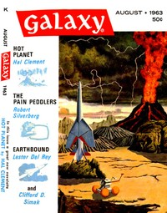

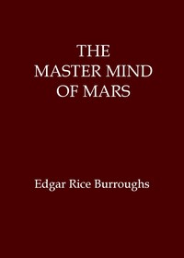
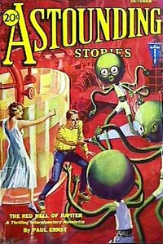
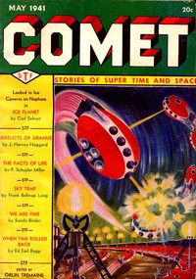
books

Slide 4
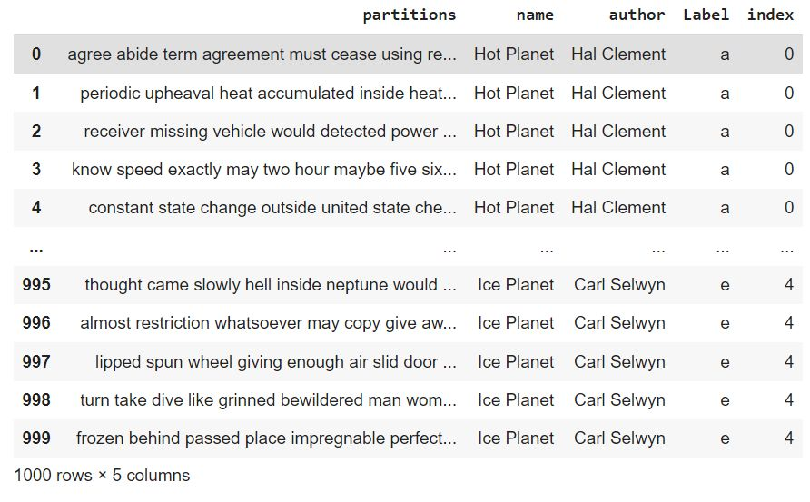
Data preparation result

Slide 5
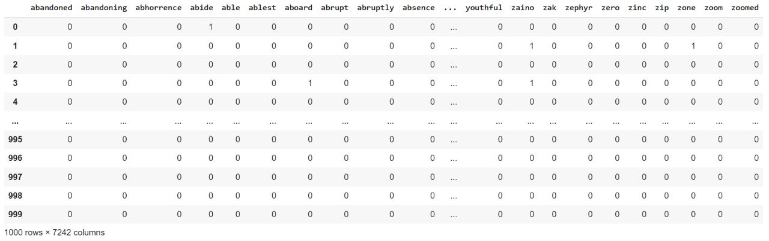
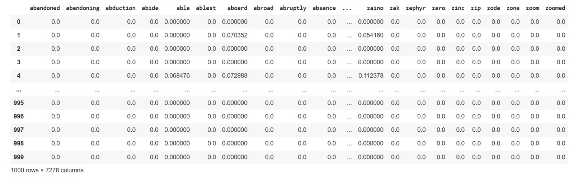
Feature engineering result
BOW
TF-IDF

Slide 6
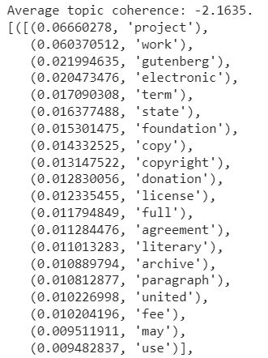
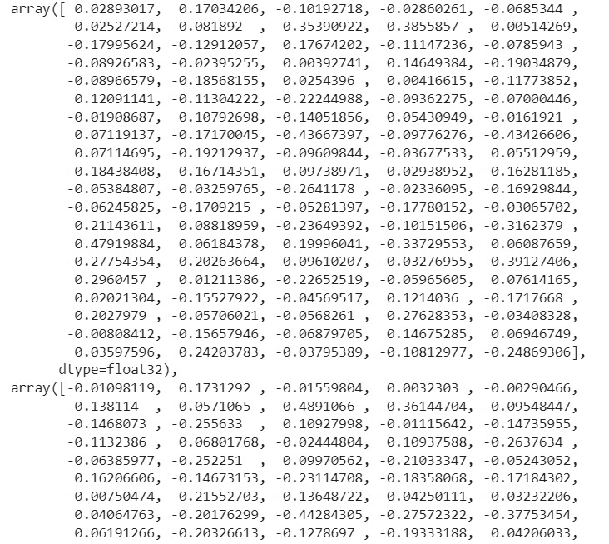
Feature engineering result
LDA
word embedding

Slide 7
ClUSTRINg models
K-means
EM
Hierarchical

Slide 8
Evaluation
Kappa
Coherence
Silhouette

Slide 9
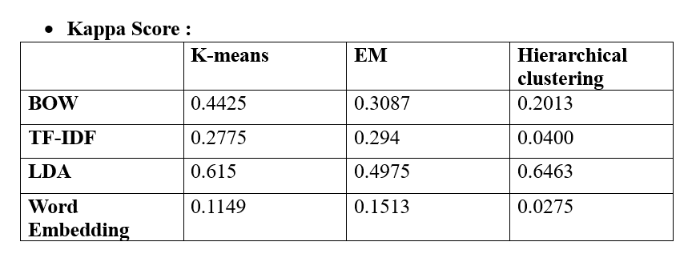
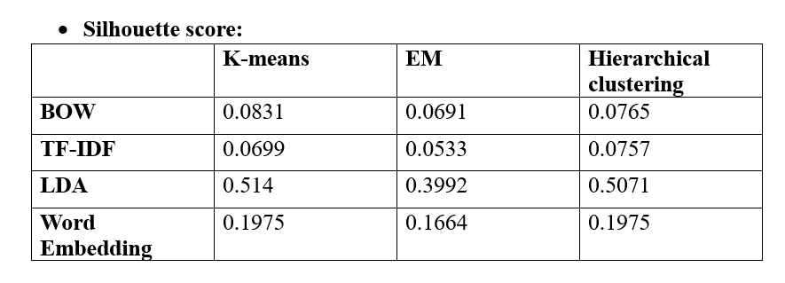
Evaluation RESULT

Slide 10
Champion model
kappa score in Hierarchical LDA = 0.64625
silhouette score in Hierarchical LDA = 0.5071429274111481
The champion model is: Hierarchical Clustering in LDA
It gives the highest Kappa and silhouette score

Slide 11
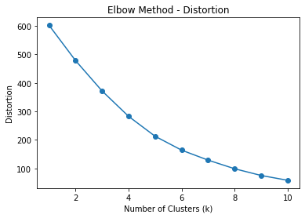
Error analysis
Elbow method for Bag of words

Slide 12
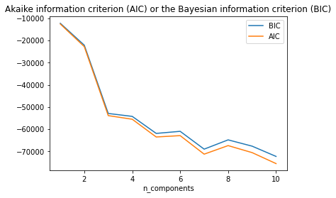
Error analysis
Akaike information criterion (AIC) and Bayesian information criterion (BIC)

Slide 13
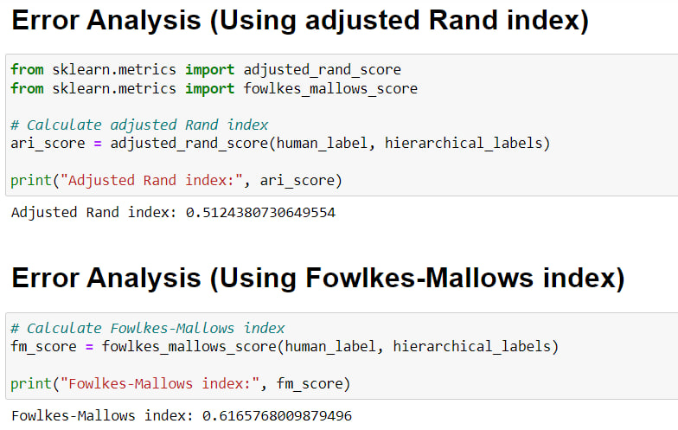
Error analysis
Using adjusted Rand index and Fowlkes-Mallows index

